Slide 1

CUSTOMER CARE RESGISTRY
CUSTOMER JOURNEY MAP
TEAM DETAILS
Team No : PNT2022TMID06554
College Name : Erode Sengunthar Engineering College
Department : B.Tech Information Technology
Team Members: M. Anitha , M. Arunkumar , P. Santhosh , A. Venkatesan

Slide 2
Date | 03 October 2022
Team ID | PNT2022TMID06554
Project Name | Project – Customer Care Registry
Maximum Marks | 4 Marks

Slide 3
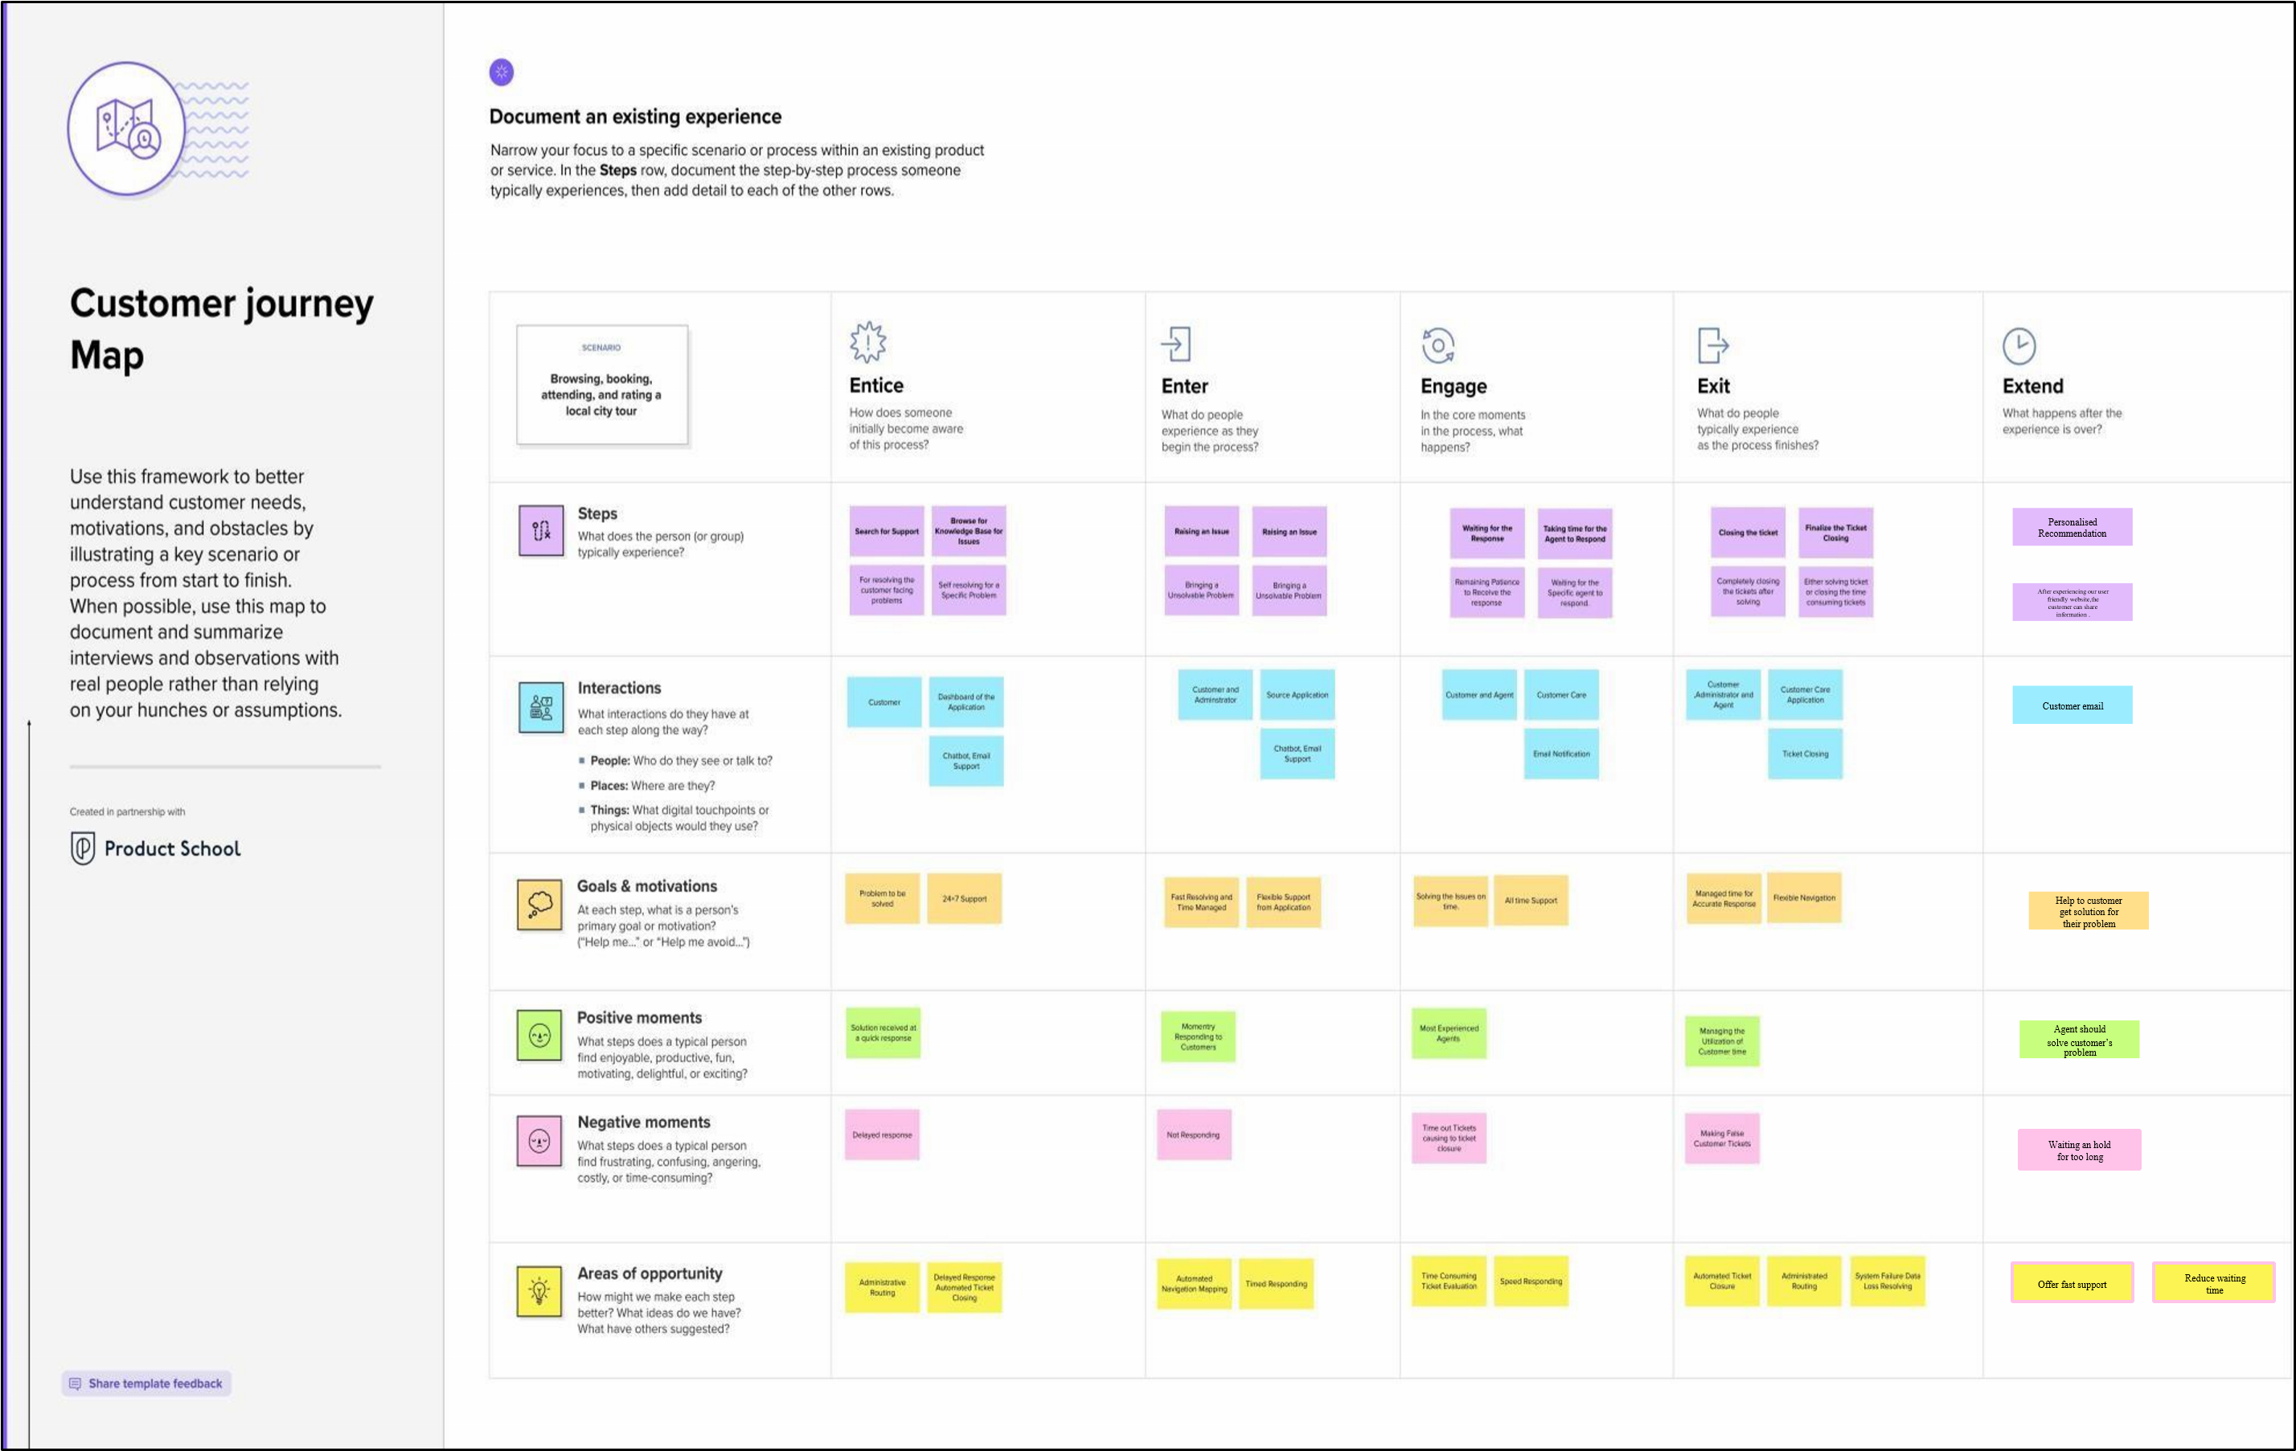

Slide 4
THANK YOU!!

